Slide 1

Week 3 - CSOPESY Activity
Designing console layouts
Diaz, Rafael Joshua - S13
Jaime, Luis Rafayel - S13
Ngo, Way We - S13
Panganiban, Joaquin Miguel - S13
1

Slide 2
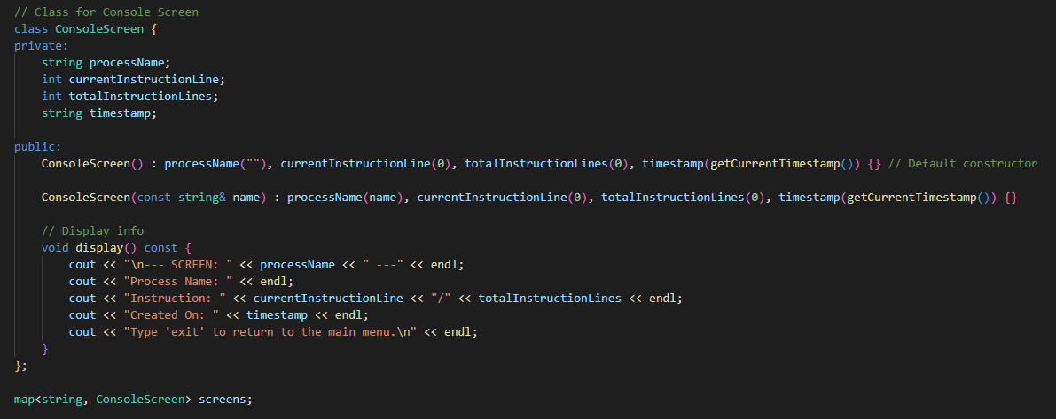
screen -s and screen -r
Display a placeholder info that contains the following:
Process name
Current line of instruction / Total line of instruction.
Timestamp of when the screen is created in (MM/DD/YYYY, HH:MM:SS AM/PM) format.
This is how it’s structured in the code.
It also supports multiple screen creations with mapping.
Since these are just placeholder values, there is no Process Name or any Instruction lines
2

Slide 3
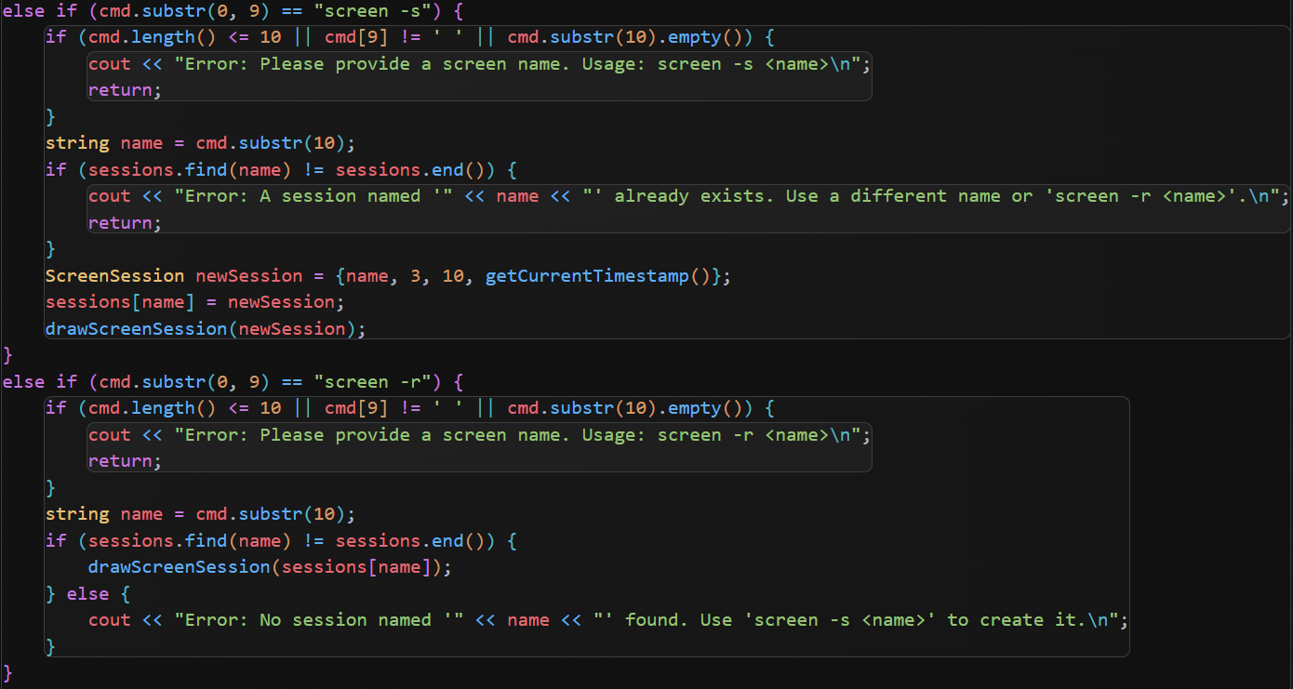
screen -s and screen -r
Typing screen -s and screen -r without a name will bring up a message.
A successful screen that is created will notify the user and can be viewed with screen -r <name>
If a screen can’t be found, it will also notify the user
3

Slide 4
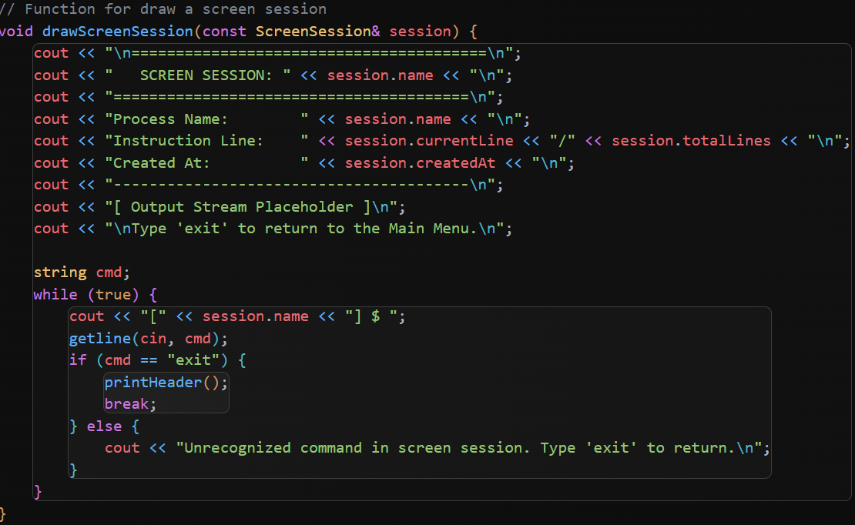
screen -s and screen -r
Once viewing a screen, it currently only allows the user to exit to the main menu
4

Slide 5
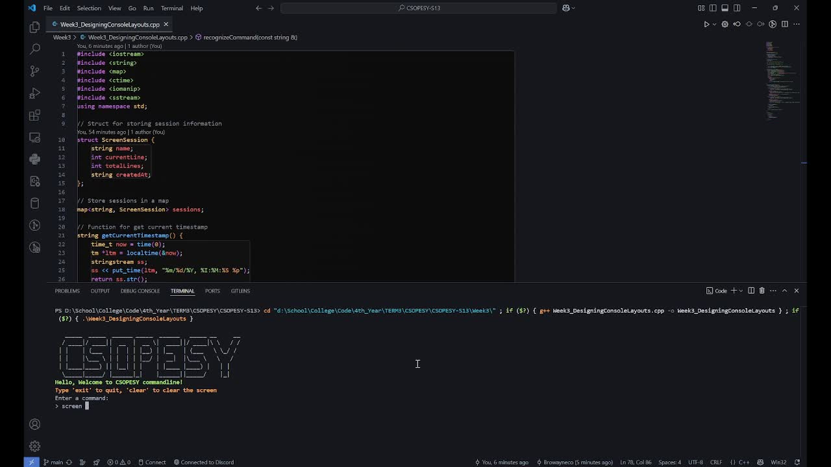
Demonstration
5

Slide 6
End of slides
6

